Slide 1
Jagran Institute Of Management
Department of MCA
MASTER OF COMPUTER APPLICATION
(Second Year-2025-26-Semester:4th )
BMC-035-Software Quality Engineering
Subject Start Date: 2nd February-2026
Name of Faculty:
Vishnu Kr. Shukla
(Assistant Professor )
Department of MCA

Slide 2
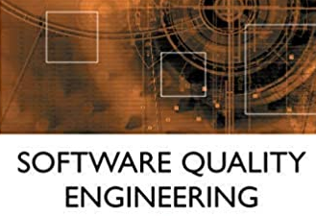

Slide 3
BMC-035-Software Quality Engineering
DETAILED SYLLABUS
UNIT-I –
Software Quality: Definition, Software Quality Attributes and Specification, Cost of Quality, Defects, Faults, Failures, Defect Rate and Reliability, Defect Prevention, Reduction, and Containment, Overview of Different Types of Software Review, Introduction to Measurement and Inspection Process, Documents and Metrics.
UNIT-II-
Software Quality Metrics Product Quality Metrics: Defect Density, Customer Problems Metric, Customer Satisfaction Metrics, Function Points.
In-Process Quality Metrics: Defect Arrival Pattern, Phase-Based Defect Removal Pattern, Defect Removal Effectiveness,
Metrics for Software Maintenance: Backlog Management Index, Fix Response Time, Fix Quality, Software Quality Indicators.

Slide 4
BMC-035-Software Quality Engineering
UNIT-III-
Software Quality Management and Models: Modeling Process,
Software Reliability Models: The Rayleigh Model, Exponential Distribution and Software Reliability Growth Models, Software Reliability Allocation Models, Criteria for Model Evaluation,
Software Quality Assessment Models: Hierarchical Model of Software Quality Assessment.
UNIT-IV-
Software Quality Assurance: Quality Planning and Control, Quality Improvement Process, Evolution of Software Quality Assurance (SQA), Major SQA Activities, Major SQA Issues, Zero Defect Software, SQA Techniques, Statistical Quality Assurance, Total Quality Management, Quality Standards and Processes

Slide 5
BMC-035-Software Quality Engineering
UNIT-V –
Software Verification, Validation & Testing: Verification and Validation, Evolutionary Nature of Verification and Validation, Impracticality of Testing all Data and Paths, Proof of Correctness, Software Testing, Functional, Structural and Error-Oriented Analysis & Testing, Static and Dynamic Testing Tools, Characteristics of Modern Testing Tools.

Slide 6
UNIT-IV-
Start-

Slide 7
UNIT-IV-
Software Quality Assurance:
Quality Planning and Control, Quality Improvement Process, Evolution of Software Quality Assurance (SQA), Major SQA Activities, Major SQA Issues, Zero Defect Software, SQA Techniques, Statistical Quality Assurance,
Total Quality Management, Quality Standards and Processes.

Slide 8
UNIT-IV
This Unit is totally devoted for Software Quality Assurance topic.

Slide 9
Before starting Software Quality Assurance- First thing we should know is
What is Software Quality (SQ)
Software Quality refers to a software which is reasonably bug or defect free is delivered in time and within the specified budget meets the requirements and/or expectations and is maintainable.
Software quality product is defined in term of its fitness of purpose.
That is, a quality product does precisely what the users want it to do.
For software products the fitness of use is generally explained in terms of satisfaction of the requirements laid down in the Software Requirements Specifications (SRS) document.
Although "fitness of purpose" is a satisfactory interpretation of quality for many devices such as a car, a table fan, a grinding machine, etc.
for software products, "fitness of purpose" is not a wholly satisfactory definition of quality.

Slide 10
Software Quality Assurance (SQA)
Software Quality Assurance (SQA) is a systematic process or methodology to ensure that the quality and reliability of the software product by monitoring the software engineering processes with a predetermined set of standards.
It's a preventive technique aimed at preventing errors by ensuring everyone follows established methods throughout the software development lifecycle, from requirements gathering to coding, testing, and releasing of the final product.
Or
Software quality assurance (SQA) is a means and practice of monitoring all software engineering processes, methods, and work products to ensure compliance against defined standards.

Slide 11
Key Aspects of Software Quality Assurance(SQA):
1. Verification and Validation: It involves both verification (ensuring the software is built correctly) and validation (ensuring the software meets user needs and requirements).
2. Process Improvement: SQA focuses on improving the development and maintenance processes through systematic activities.
3. Standard Compliance: It ensures that software engineering activities conform to company and industry standards.
4. Risk Mitigationजोखिम न्यूनीकरण : SQA helps identify and address potential issues early in the development cycle, reducing the risk of costly rework later.
5. Customer Satisfaction: Ultimately, SQA aims to deliver software that meets customer expectations and provides a high-quality user experience.

Slide 12
Software Quality Assurance (SQA)
Software Quality Assurance (SQA) Activities: There are several activities involve-
1. Process Definition and Implementation:-
Establishing and documenting quality assurance processes and procedures.
2. Auditing:-
Regularly reviewing the software development process to ensure compliance with standards and identify areas for improvement.
3. Training:-
Providing developers and other team members with the necessary knowledge and skills to implement and adhere to SQA practices.
4. Testing:-
Conducting various types of testing (e.g., unit, integration, system) to identify defects and ensure the software functions as intended.
5. Defect Tracking and Management:-
Using a systematic approach to track and resolve defects, ensuring they are addressed in a timely manner.

Slide 13
How to implement of Software Quality Assurance (SQA)-
it is essential to follow a structured approach. You can follow the below-mentioned steps to implement SQA:
Define quality standards: Clearly define the quality standards that your software product must meet. This includes defining requirements, acceptance criteria, and performance metrics. These standards should be agreed upon by all stakeholders, including the development team, management, and customers.
Plan SQA activities: Develop a plan for the SQA activities that will be performed throughout the software development life cycle. This plan should include reviews, testing, and documentation activities. It should also specify who will be responsible for each activity and when it will be performed.
Conduct reviews: Conduct reviews of software artifacts such as requirements, design documents, and code. These reviews should be conducted by a team of experts who are not directly involved in the development process. This will help identify defects early in the development process and reduce the cost of fixing them later.

Slide 14
Perform Testing: Perform different types of testing such as unit testing, integration testing, system testing, and acceptance testing. Use automated testing tools to increase efficiency and reduce the risk of human error.
Monitor and Measure: Monitor and measure the quality of the software product throughout the development process. This includes tracking defects, analyzing metrics such as code coverage and defect density, and conducting root cause analysis.
Improve Continuously: Continuously improve the SQA process by analyzing the results of the monitoring and measuring activities. Use this data to identify areas for improvement and implement changes to the SQA process.

Slide 15
Fundamentals of Software Quality Assurance:-
Understanding the fundamentals of Software Quality Assurance (SQA) is crucial for developing software that is robust, reliable, and meets user expectations. SQA encompasses various practices, methodologies, and frameworks designed to ensure the quality of software products throughout the software development lifecycle (SDLC).
Here’s a detailed look at the core fundamentals of SQA:
1. Quality Planning
Quality planning involves defining specific quality standards for projects and determining the necessary processes to achieve these standards. This stage sets the foundation for what the quality goals are and how they will be measured. It includes establishing quality policies, objectives, and criteria for accepting software products.
2. Quality Control (QC)
Quality control is the process of enforcing quality standards by inspecting and testing the software product during and after development. There are various
QC activities involve:
Testing: Systematic execution of software to identify bugs and ensure that functionalities meet the specified requirements.
Inspections and Reviews: Formal and informal reviews of the software, including code reviews, design reviews, and requirement reviews to catch defects early in the process.

Slide 16
3. Quality Assurance:-While quality control focuses on the output, quality assurance focuses on improving the processes used to make the product. This includes:
Process Standardization: Developing and following standardized processes to reduce variability and increase predictability.
Process Evaluation and Improvement: Continually evaluating processes for effectiveness and efficiency, using models and standards such as CMMI (Capability Maturity Model Integration) and ISO 9001.
4. Quality Management:
This encompasses all activities related to maintaining and enhancing the quality of the software.
It includes:
Leadership Engagement: Ensuring that the organization’s leadership understands and supports quality initiatives.
Resource Management: Allocating and managing resources effectively to maintain quality standards.
Risk Management: Identifying, analyzing, and mitigating risks that could impact software quality.

Slide 17
5. Software Metrics and Measurement:-
Metrics and measurements are crucial for assessing the effectiveness of SQA activities.
Common metrics include:
Defect Density: The number of defects confirmed in software divided by the size of the software.
Code Coverage: A measure of how much code is executed during testing, which helps in understanding the extent of testing.
Customer Satisfaction: Feedback from users about the software’s performance and features.
6. Preventive and Corrective Actions:-
Preventive Actions: Steps taken to eliminate the causes of potential nonconformities or defects.
Corrective Actions: Actions taken to eliminate the causes of detected nonconformities or defects.

Slide 18
7. Continuous Improvement
The principle of continuous improvement, often referred to by its Japanese name, "Kaizen," is integral to SQA. This involves ongoing efforts to improve all processes, based on feedback and iterative learning. Techniques like retrospectives, post-mortem analyses, and process refinement sessions are used to analyze successes and failures and to implement lessons learned.

Slide 19
SQA Processes and Techniques
Software Quality Assurance (SQA) involves various processes and techniques that help ensure the quality of software throughout the development lifecycle. These methodologies are designed to prevent defects, ensure functionality meets specified requirements, and maintain a high standard of software performance. Here’s an in-depth look at some key SQA processes and techniques:
1. Code Reviews:-
Code reviews are a critical SQA activity where other developers (peers) review the source code written by a developer before it merges into the main branch. This practice aims to catch errors early in the development phase, promote a higher code quality standard, and share knowledge across the team.
They include several benefits-
Detecting bugs early in the software development process.
Improving the overall design and maintainability of the code.
Enhancing coding skills across the team through peer feedback.

Slide 20
2. Automated Testing:-
Automated testing uses software tools to run tests on the software automatically, checking for errors, defects, and functional mismatches. This can include:
(A). Unit Testing: Testing individual units or components of a software application.
(B). Integration Testing: Testing combined parts of an application to determine if they function together correctly.
(C). System Testing: Testing the complete and integrated software product to evaluate the system’s compliance with its specified requirements.
Automated testing is valuable because it can be executed quickly and repeatedly, which is crucial for continuous integration and delivery pipelines.

Slide 21
3. Continuous Integration and Continuous Delivery (CI/CD):-
CI/CD is a method to frequently deliver apps to customers by introducing automation into the stages of app development.
The main concepts attributed to CI/CD are continuous integration, continuous delivery and continuous deployment. CI/CD is intended to:
Reduce risks in software development.
Ensure that software can be reliably released at any time.
Help developers to detect and locate errors quickly.
4. Static and Dynamic Analysis:-
(A). Static Analysis: This technique involves analyzing the code without executing it. It’s used to detect coding errors, security lapses, and compliances with coding guidelines.
(B). Dynamic Analysis: Unlike static analysis, dynamic analysis involves executing code. It provides insights into the system's behavior and verifies that the system performs expected tasks under varying conditions.

Slide 22
5. Risk-Based Testing:-
Risk-based testing prioritizes testing of features and functions in the software application based on the risk of failure, the importance and likelihood of failure, and the impact of failure. This approach helps to optimize test efforts towards the most critical areas of the system.
6. Test-Driven Development (TDD):-
TDD is a software development approach in which tests are written before the code that needs to be tested.
The process follows a simple cycle:
Write a test for a new function.
Run the test and see it fail.
Implement the function.
Run the test again and see it succeed.
Refactor the code for optimization.

Slide 23
This technique ensures that the software is tested at the function level and that all functionalities are covered by the tests, which improves code quality.
7. Performance Testing:-
This type of testing is performed to determine how a system performs in terms of responsiveness and stability under a particular workload.
It can involve load testing, stress testing, and spike testing, among others, to ensure the software application behaves as expected under varied conditions.

Slide 24
Example: Consider a functionally correct software product. That is, it performs all tasks as specified in the SRS document.
But, has an almost unusable user interface. Even though it may be functionally right, we cannot consider it to be a quality product.
In the software engineering context, software quality reflects both functional quality as well as structural quality.
1. Software Functional Quality
2. Software Structural Quality
3. Software Quality Assurance
4. Software Quality Control

Slide 25
1. Software Functional Quality − It reflects how well it satisfies a given design, based on the functional requirements or specifications.
2. Software Structural Quality − It deals with the handling of non-functional requirements that support the delivery of the functional requirements, such as robustness or maintainability, and the degree to which the software was produced correctly.
3. Software Quality Assurance − Software Quality Assurance (SQA) is a set of activities to ensure the quality in software engineering processes that ultimately result in quality software products. The activities establish and evaluate the processes that produce products. It involves process-focused action.
4. Software Quality Control − Software Quality Control (SQC) is a set of activities to ensure the quality in software products. These activities focus on determining the defects in the actual products produced. It involves product-focused action.

Slide 26
The modern view of a quality associated with a software product several quality methods such as the following:
1. Portability: A software device is said to be portable, if it can be freely made to work in various operating system environments, in multiple machines, with other software products, etc.
2 . Usability: A software product has better usability if various categories of users can easily invoke the functions of the product.
3. Reusability: A software product has excellent reusability if different modules of the product can quickly be reused to develop new products.
4. Correctness: A software product is correct if various requirements as specified in the SRS document have been correctly implemented.
5. Maintainability: A software product is maintainable if bugs can be easily corrected as and when they show up, new tasks can be easily added to the product, and the functionalities of the product can be easily modified, etc.

Slide 27
What is Software Quality Assurance(SQA):
What is Quality?
Quality is extremely hard to define, and it is simply stated: “Fit for use or purpose.” It is all about meeting the needs and expectations of customers with respect to functionality, design, reliability, durability, & price of the product.
What is Assurance?
Assurance is nothing but a positive declaration on a product or service, which gives confidence. It is certainty of a product or a service, which it will work well.
It provides a guarantee that the product will work without any problems as per the expectations or requirements.

Slide 28
The IEEE definition for software quality assurance is as follows-
"A planned and systematic pattern of all actions necessary to provide adequate confidence that an item or product conforms to established technical requirements. A set of activities designed to evaluate the process by which the products are developed or manufactured.“
OR
Software Quality Assurance (SQA) is a set of activities for ensuring quality in software engineering processes. It ensures that developed software meets and complies with the defined or standardized quality specifications.
SQA is an ongoing process within the Software Development Life Cycle (SDLC) that routinely checks the developed software to ensure it meets the desired quality measures.

Slide 29
Another definition of Software quality assurance (SQA) is a means and practice of monitoring the software engineering processes and methods used in a project to ensure proper quality of the software.
It may include ensuring conformance to standards or models, such as ISO/IEC 9126 (now superseded by ISO 25010), SPICE or CMMI.
Note:- Software Process Improvement and Capability Determination (SPICE) is an international framework to assess software development processes.
SPICE was developed jointly by International Organization for Standardization (ISO) and the International Electro technical Commission (IEC).

Slide 30
It includes standards and procedures that managers, administrators or even developers may use to review and audit software products and activities to verify that the software meets quality criteria which link to standards.
According to Automotive SPICE (which is based on ISO/IEC 15504), that provides the independent assurance that all work products, activities and processes comply with the predefined plans and quality strategies.
SQA encompasses the entire software development process, including requirements engineering, software design, coding, code reviews, source code control, software configuration management, testing, release Management and software integration. It is organized into goals, commitments, abilities, activities, measurements, verification and validation.

Slide 31
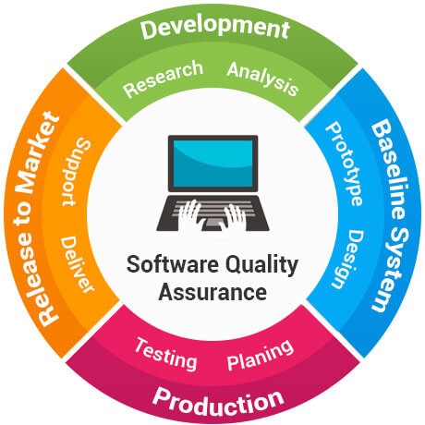

Slide 32
Objectives of SQA Activities:-
The objectives of SQA activities are as follows −
1. In Software development (process-oriented)
2. In Software maintenance (product-oriented)
1. In Software development (process-oriented)
Assuring an acceptable level of confidence that the software will conform to functional technical requirements.
Assuring an acceptable level of confidence that the software will conform to managerial scheduling and budgetary requirements.
Initiating and managing activities for the improvement and greater efficiency of software development and SQA activities.

Slide 33
2. In Software maintenance (product-oriented):-
Assuring with an acceptable level of confidence that the software maintenance activities will conform to the functional technical requirements.
Assuring with an acceptable level of confidence that the software maintenance activities will conform to managerial scheduling and budgetary requirements.
Initiating and managing activities to improve and increase the efficiency of software maintenance and SQA activities. This involves improving the prospects of achieving functional and managerial requirements while reducing costs.

Slide 34
Organizing for Quality Assurance
The quality assurance organizational framework that operates within the organizational structure includes the following participants −
Managers:-
Top management executives, especially the executive directly in charge of software quality assurance.
Software development and maintenance department managers.
Software testing department managers.
Project managers and team leaders of development and maintenance projects.
Leaders of software testing teams.

Slide 35
Testers:-
Members of software testing teams
SQA professionals and interested practitioners −
SQA trustees
SQA committee members
SQA forum members
SQA unit team members
Only the managers and employees of the software testing department are occupied full time in the performance of SQA tasks.
The others dedicate part of their time to quality issues, whether during fulfillment of their managerial functions or professional tasks, or as volunteers in others, most often a SQA committee, a SQA forum, or as SQA trustees.

Slide 36
Software Quality Assurance Planning:-
Abbreviated as SQAP, the software quality assurance plan comprises of the procedures, techniques, and tools that are employed to make sure that a product or service aligns with the requirements defined in the SRS(software requirement specification).
Quality Assurance is one of the key facilitating processes during project planning. It is an ongoing activity that is performed with other planning processes.
Quality planning is aimed at identifying the relevant quality standards, incorporating quality standards into product and processes, determining how these standards will be achieved.

Slide 37
A quality plan is a document, or several documents, that together specify quality standards, practices, resources, specifications, and the sequence of activities relevant to a particular product, service, project, or contract.
The scope of this document is to describe all the software processes and documents used for the quality assurance of the statistical analysis tool.
This plan identifies the responsibilities of the project developer, lists the activities, processes and work products that will be reviewed and audited Identifies the work products.
Example:-Before a project manager can plan for quality, he must know what the standard expectations are. In other words, he must be aware of the quality policy defined by the organization’s top management.

Slide 38
It specifies the general intention of the organization with reference to quality as formally expressed by the highest management. It should be documented. The project team should adopt the quality policy of the organization to guide the project implementation.
If there is no quality policy or project that involves multiple performing organizations, in the case of a joint venture, then the project management team should create a quality policy. The project stakeholders should be fully aware of the quality policy.
The project scope statement is another important input to quality planning. It defines important input to quality planning.
It defines what will and what will not be delivered as part of the project along with project objectives regarding cost, schedule, and cost. Other inputs to the quality planning include a description of the product to be designed, standards, and regulations that may affect the project and outputs from the other processes.
Once the project manager has gathered the required inputs and evaluated the product description and quality assurance, he is able to measure the quality. Quality measurements are used for making estimates, tracking projects progress, analyzing defects and achieving continuous improvement, and evaluating tools.

Slide 39
The plan identifies the SQA responsibilities of a team, lists the areas that need to be reviewed and audited. It also identifies the SQA work products.
The SQA plan document consists of the below sections:
Purpose section
Reference section
Software configuration management section
Problem reporting and corrective action section
Tools, technologies and methodologies section
Code control section
Records: Collection, maintenance and retention section
Testing methodology

Slide 40
Quality plans should define:
Objectives to be attained (for example, characteristics or specifications, uniformity, effectiveness, aesthetics, cycle time, cost, natural resources, utilization, yield, dependability, and so on)
Steps in the processes that constitute the operating practice or procedures of the organization
Allocation of responsibilities, authority, and resources during the different phases of the process or project
Specific documented standards, practices, procedures, and instructions to be applied
Suitable testing, inspection, examination, and audit programs at appropriate stages
A documented procedure for changes and modifications to a quality plan as a process is improved
A method for measuring the achievement of the quality objectives
Other actions necessary to meet the objectives
At the highest level, quality goals and plans should be integrated with overall strategic plans of the organization. As organizational objectives and plans are deployed throughout the organization, each function fashions its own best way for contributing to the top-level goals and objectives.
At lower levels, the quality plan assumes the role of an actionable plan. Such plans may take many different forms depending on the outcome they are to produce. Quality plans may also be represented by more than one type of document to produce a given outcome.

Slide 41
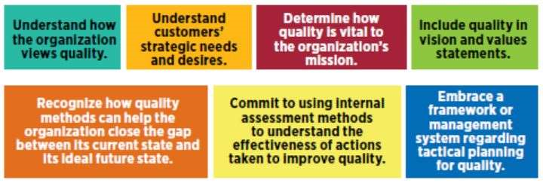
.

Slide 42
HOW TO WRITE A QUALITY PLAN-
Quality assurance or quality control plans evaluate and/or modify an organization’s procedures to help ensure they provide the desired results. Quality control plans are often viewed as a set of instructions that should be followed.
They document the planning, implementation, and assessment procedures for a project, as well as any QA or QC activities.
Some areas may be more detailed than others, based on the project, process, or organization’s needs. It is important to note that each plan is unique based on the organization’s needs and their quality management system (QMS).

Slide 43
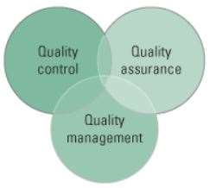
However, quality control plans should always have a structure that permits improvements to the plan. This allows employees to offer input on how to improve efficiency and quality. In addition, the plan should be reviewed by others periodically, including stakeholders, to ensure the plan is comprehensive.

Slide 44
What is Software Quality Control SQC?
Software Quality Control(SQC) is a set of procedures or methods used by organizations to achieve product quality parameters or software product will meet its quality goals at the best value to the customer, and to continually improve the organization’s ability to produce software products in the future.
Software Quality Control is limited to the Review/ Testing phases of the SDLC and the goal is to ensure that the products meet specifications/ requirements.
Or
Software quality control refers to specified functional requirements as well as non-functional requirements such as supportability, performance and usability.
It also refers to the ability for software to perform well in unforeseeable scenarios and to keep a relatively low defect rate.
Note: These specified procedures and outlined requirements lead to the idea of Verification and Validation and software testing.

Slide 45
Quality Control is a strategy of detection – it uses operational techniques and procedures to identify defects in products and services and ensure that the project deliverables meet the desired quality standards.
The Quality Control process detects bugs and defects in the product and reports them so that they can be fixed. If a problem is identified, it must be resolved before the product is delivered to customers.
Quality Control is also part of quality management. However, QC is focused on fulfilling quality requirements. Broadly speaking, it is the inspection aspect of quality management.
In conclusion point of view:
Quality Control is the final checkpoint before the delivery of software product.

Slide 46
Examples of Quality Control activities:
Inspection,
Measurements,
Manual and Automated Testing,
Verification, and Validation.

Slide 47
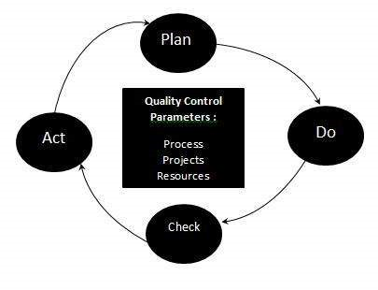
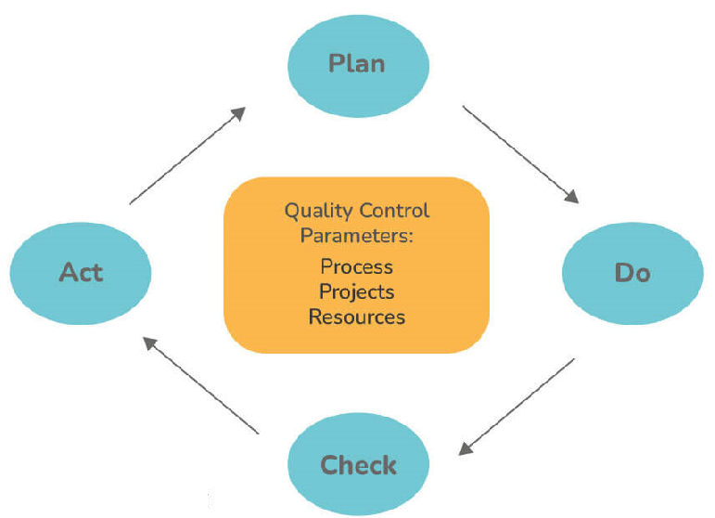
Quality Assurance or Quality Control Process:
The three class parameters that control software quality are:
Processes
Projects
Resources

Slide 48
The total quality control process consists of:
1. Plan - The organization should prepare and set the process-related goals and decide the procedures necessary to produce a high-quality final result. Or It is the stage where the Quality control processes are planned
2. Do - Development and testing of systems and even ‘do’ modifications to processes. Or Use a defined parameter to develop the quality.
3. Check Monitoring processes, modifying processes, and checking if they follow the predetermined goals. Or Stage to verify if the quality of the parameters are met.
4. Act Implement steps that are required to improve processes. Or Take corrective action if needed and repeat the work
The organization must use Quality Assurance to ensure that the product is designed and delivered correctly. This tends to reduce complications and errors in the end product.

Slide 49
Software Quality Control Activities.(In Shorts )
Step : Check that assumptions and criteria for the selection of data and the different factors related to data are documented.
Step : Check for transcription errors in data input and reference.
Step :-Check the integrity of database files.
Step :- Check for consistency in data.
Step :- Check that the movement of inventory data among processing steps is correct.
Step :- Check for uncertainties in data, database files etc.
Undertake review of internal documentation.
Step:- Check methodological and data changes resulting in recalculations.
Step :- Undertake completeness checks.
Step :- Compare Results to previous Results.

Slide 50
SQC Activities:-
It includes the following activities:
Reviews:-
Requirement Review
Design Review
Code Review
Deployment Plan Review
Test Plan Review
Test Cases Review
Testing Levels:-
Unit Testing
Integration Testing
System Testing
Acceptance Testing
The process of Software Quality Control (SQC) is governed by Software Quality Assurance (SQA). While SQA is oriented towards prevention, SQC is oriented towards detection.

Slide 51
SQA Activities:-
Given below is the list of SQA activities:
#1) Creating an SQA Management Plan:
The foremost activity includes laying down a proper plan regarding how the SQA will be carried out in your project.
Along with what SQA approach you are going to follow, what engineering activities will be carried out, and it also includes ensuring that you have a right talent mix in your team.
#2) Setting the Checkpoints:
The SQA team sets up different checkpoints according to which it evaluates the quality of the project activities at each checkpoint/project stage. This ensures regular quality inspection and working as per the schedule.

Slide 52
#3) Apply software Engineering Techniques:
Applying some software engineering techniques aids a software designer in achieving high-quality specification. For gathering information, a designer may use techniques such as interviews and FAST (Functional Analysis System Technique).
Later, based on the information gathered, the software designer can prepare the project estimation using techniques like WBS (work breakdown structure), SLOC (source line of codes), and FP(functional point) estimation.
#4) Executing Formal Technical Reviews:
An FTR is done to evaluate the quality and design of the prototype.
In this process, a meeting is conducted with the technical staff to discuss regarding the actual quality requirements of the software and the design quality of the prototype. This activity helps in detecting errors in the early phase of SDLC and reduces rework effort in the later phases.

Slide 53
#5) Having a Multi- Testing Strategy:
By multi-testing strategy, we mean that one should not rely on any single testing approach, instead, multiple types of testing should be performed so that the software product can be tested well from all angles to ensure better quality.
#6) Enforcing Process Adherence:
This activity insists the need for process adherence during the software development process. The development process should also stick to the defined procedures.

Slide 54
This activity is a blend of two sub-activities which are explained below in detail:
(i) Product Evaluation:
This activity confirms that the software product is meeting the requirements that were discovered in the project management plan. It ensures that the set standards for the project are followed correctly.
(ii) Process Monitoring:
This activity verifies if the correct steps were taken during software development. This is done by matching the actually taken steps against the documented steps.
#7) Controlling Change:
In this activity, we use a mix of manual procedures and automated tools to have a mechanism for change control.
By validating the change requests, evaluating the nature of change and controlling the change effect, it is ensured that the software quality is maintained during the development and maintenance phases.

Slide 55
#8) Measure Change Impact:
If any defect is reported by the QA team, then the concerned team fixes the defect.
After this, the QA team should determine the impact of the change which is brought by this defect fix. They need to test not only if the change has fixed the defect, but also if the change is compatible with the whole project.
For this purpose, we use software quality metrics which allows managers and developers to observe the activities and proposed changes from the beginning till the end of SDLC and initiate corrective action wherever required.
#9) Performing SQA Audits:
The SQA audit inspects the entire actual SDLC process followed by comparing it against the established process.
It also checks whatever reported by the team in the status reports were actually performed or not. This activity also exposes any non-compliance issues.

Slide 56
#10) Maintaining Records and Reports:
It is crucial to keep the necessary documentation related to SQA and share the required SQA information with the stakeholders. The test results, audit results, review reports, change requests documentation, etc. should be kept for future reference.
#11) Manage Good Relations:
In fact, it is very important to maintain harmony between the QA and the development team.
We often hear that testers and developers often feel superior to each other. This should be avoided as it can affect the overall project quality.

Slide 57
Why you should implement QC in software development:-
Quality Control, similarly to Quality Assurance, reduces costs. Customer needs are better satisfied - when you combine QC activities with requirements engineering processes, you get minimal consumer complaints after the software is delivered.
Quality Control reveals common errors so they can be avoided in the future.
It develops and promotes quality awareness among employees, which is a great help in attaining the required quality level of the product.
Quality Control increases the competitiveness of the company as it delivers better quality software and meets the requirements of the customer.

Slide 58
Points | Quality Assurance | Quality Control
Definition | QA is a group of activities which ensures that the quality of processes which is used during the development of the software always be maintained. | QC is a group of activities to detect the defects in the developed software.
Focus | The focus of QA is to prevent defects in the developing software by paying attention to processes. | The focus of QC is to identify defects in the developed software by paying attention to testing processes.
How | Establishment of the high-quality management system and periodic audits for conformance of the operations of the developing software. | Detecting and eliminating the quality problem elements by using testing techniques and tools in the developed software.
What | QA ensures prevention of quality problem elements by using systematic activities including documentation. | QC ensures identification and elimination of defects by using processes and techniques to achieve and maintain high quality of the software.
Orientation | QA is process oriented. | QC is product oriented.
Type of process | QA is a proactive process. It concerns to improve development so; defects do not arise in the testing period. | QC is a reactive process because it concerns to identify defects after the development of product and before its release.
Responsibility | Each and every member of the development team is responsible for QA | Only the specific testing team is responsible for QC
Example | Verification is the example of QA | Validation is the example of QC

Slide 59
Quality Improvement
What Is Quality Improvement?
Quality improvement is a structured approach to evaluating the performance of systems and processes, then determining needed improvements in both functional and operational areas. Successful efforts rely on the routine collection and analysis of data.
Basics of Quality Improvement:-
Quality improvement (QI) is a systematic, formal approach to the analysis of practice performance and efforts to improve performance.
A variety of approaches—or QI models—exist to help you collect and analyze data and test change.
While it’s important to choose a reputable QI model to guide your efforts, it’s more important that you fully commit to using the QI process and good QI practices.

Slide 60
What are the steps in the quality improvement process?
9 steps used in quality improvement process?
List and prioritize improvement opportunities.
Define the improvement objectives.
Define the requirements.
Collect and organize data.
Select the root cause.
Generate potential solutions.
Select the best solution.
Implement the solution and evaluate the result.

Slide 61
Evolution of Software Quality Assurance (SQA):
What is meant by software quality assurance?
Software quality assurance (SQA) is a means and practice of monitoring the software engineering processes and methods used in a project to ensure proper quality of the software.
It may include ensuring conformance to standards or models, such as ISO/IEC 9126 (now superseded by ISO 25010), SPICE or CMMI.
It includes standards and procedures that managers, administrators or even developers may use to review and audit software products and activities to verify that the software meets quality criteria which link to standards.

Slide 62
SQA encompasses the entire software development process, including
requirements engineering,
software design,
coding,
code reviews,
source code control,
software configuration management,
testing,
release management and
software integration.
It is organized into goals, commitments, abilities, activities, measurements, verification and validation.

Slide 63

The Evolution of Software QA
1960’s “Code and Ship”:- Software began to find its way into systems procured by the US Dept. of Defense (DoD). These projects were consistently behind schedule, over budget, and had many technical problems.
Frequently, software never worked as intended and many projects were cancelled before anything was delivered.

Slide 64
The DoD was frequently unaware of schedule, budget, and technical problems until late into the program – when they were often unable to understand them and assess their impact.
An “independent software tester” was hired to “perform additional, unbiased testing of the software”.
By employing someone who was totally separate from the software development contractor, the DoD hoped to get a more accurate and objective technical assessment of the project’s status.

Slide 65
1970 – 80’s “Code and Ship Crisis”
During the 1970’s, as software development activity began to expand into the private sector, software development companies were experiencing the same poor results as did government agencies a decade earlier. Companies had difficulty delivering software within the constraints of schedule, budget, and quality. Most companies relied on developers to test their own code and report on issues.
During the 1980’s, we experienced what became known as the “software crisis” – the point in time when spending on software maintenance exceeded spending on creating new software products. The “software crisis” brought with it a host of changes and the emergence of SQA.
While SQA was viewed as the “poor stepchild” of software development, many enlightened companies saw measurable benefit from integrating SQA into the software development process.

Slide 66
1990’s “Code, Test and Ship”
By the 1990’s, many software companies had SQA functions within their organizations. Yet, high-profile software failures continued to occur.
Complexity of software developed during the 90’s increased significantly.
Competitive business pressures also increased significantly.
Software was being used in many new areas – especially areas that were life-threatening.
Many people working in SQA received little formal training in SQA. SQA engineers were expected to learn their craft primarily from on-the-job training.
Universities failed to recognize that SQA is a legitimate discipline unto itself and that it requires specialized training.

Slide 67
2000’s “SQA Processes adopted”
The SQA department is a standard role in any major software development lifecycle and mandated by any standard outsourcing contract for software.
Government legislation requires that critical software has met standard SQA analysis, particularly regarding identity and security issues.
Various standards organizations(such as ISO, IEEE, CMM) have been created to evaluate and improve an organization’s ability to produce quality software.
Notes: Universities offer a wide range of SQA courses and areas of specialization.
SQA Certification (CSTE, CSQA, CMSQ) and/or a Computer Science degree from an accredited organization is a standard expectation for new engineers entering the SQA field.
SQA User groups and conventions are common in major cities around the world.

Slide 68
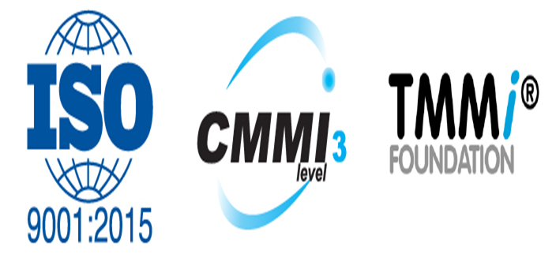
Software Quality Assurance Standards:-
Quality is hard to define. When you think of something that is of good quality, does that mean that something is excellent — because that is a subjective measure — or simply fit to fulfill its purpose?
While on the surface software quality assurance might seem just as ambiguous, there are several different guidelines for SQA that are well-recognized in the industry. It’s kind of like the scientific process, except there are multiple.
In general, SQA may demand conformance to one or more standards.
1. ISO 9000:
2. CMMI level
3. TMMi Level

Slide 69
Some of the most popular standards are discussed below:
1. ISO 9000: The ISO 9000 defines a family of standards, with the ISO 9000 and ISO 9001 being standards within the family. The International Organization for Standardization (ISO) first published the ISO 9000 family in 1987.
For the ISO 9000, there are several principles that put significant focus on a software product’s ability to meet customers’ needs.
The ISO 9000 principles are as follows:
Customer focus
Leadership
Engagement of people
Process Approach
Improvement
Evidence-based decision making
Relationship management
Currently, the ISO 9000 is one of the more widely used criteria for quality management systems (QMS). More than a million businesses and organizations across the world in 170 countries have an ISO 9001 certification.

Slide 70
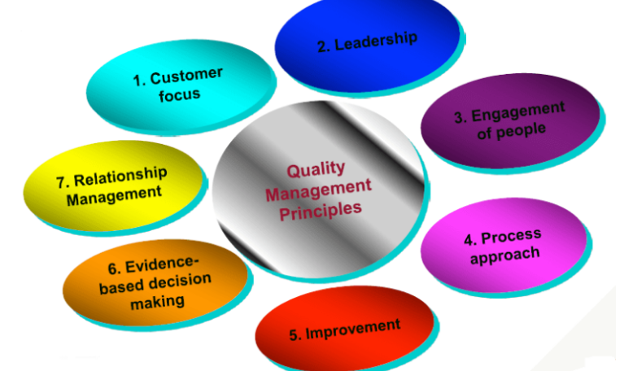
This standard is based on seven quality management principles which help the organizations to ensure that their products or services are aligned with the customer needs’.
7 principles of ISO 9000 are depicted in the below image:

Slide 71
2. CMMI level: CMMI stands for Capability maturity model Integration. This model was originated in software engineering. It can be employed to direct process improvement throughout a project, department, or an entire organization.
Testing Maturity Model (TMM) or Testing Maturity Model integration (TMMi) is based on CMMI. Launched by the TMMi Foundation in 2005, it was designed to be complementary to the CMMI.
This model delineates standards for software testing. Like CMMI, TMMi uses the concept of maturity levels. The five maturity levels are:
An organization is appraised and awarded a maturity level rating (1-5) based on the type of appraisal.
Initial
Managed-Test Policy & Strategy
Test Planning
Test Monitoring and Control
Test Design & Execution
Test Environment
Defined-Test Organization
Test Training Program
Test Lifecycle & Integration
Non-Functional Testing
Peer Reviews
Measured -Test Measurement
Product Quality Evaluation
Advanced Reviews
Optimization -Defect Prevention
Test Process Optimization
Quality Control
Because TMMi is rather young, it is even less popular than CMMI.

Slide 72
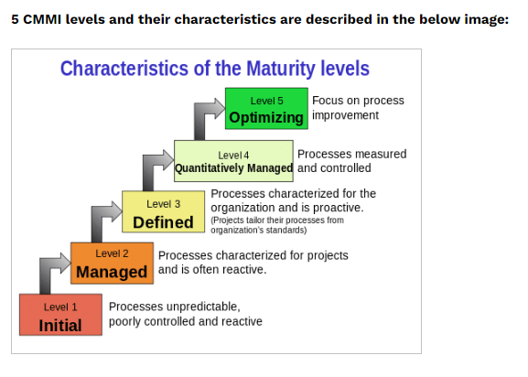

Slide 73
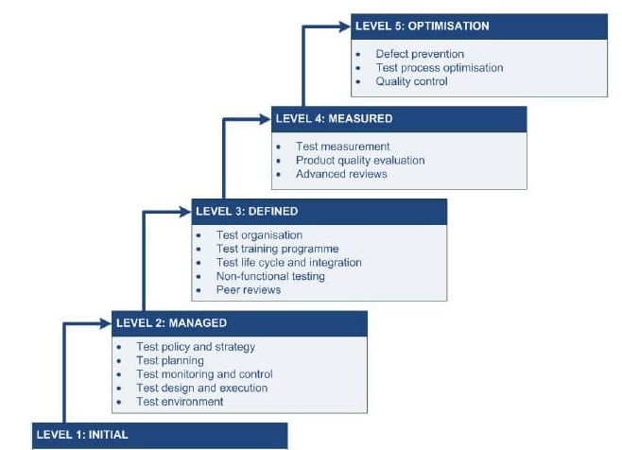
3. Test Maturity Model integration (TMMi): Based on CMMi, this model focuses on maturity levels in software quality management and testing.
As an organization moves on a higher maturity level, it achieves a higher capability for producing high-quality products with fewer defects and closely meets the business requirements.

Slide 74
Major Software Quality Assurance Issues/Identifying SQA Issues:-
Quality assurance testing is an important part of software development, particularly as projects grow in size and complexity. After all, a bug that goes unnoticed will become progressively more expensive to fix over time and could cause significant usability issues before being patched. Effective QA teams can pre-emptively find and help eliminate bugs before they reach production servers to reduce development costs and ensure an optimal user experience.
Software Quality Assurance is a good practice that every large scale business should employ. IT related businesses have never hesitated to use SQA to ensure that the application they will release for their users or sell to their customers will live up to their expectations.

Slide 75
1. SQA Cost
This is the main reason why small scale companies hesitated to use SQA as part of their development plan. SQA is a different entity that works separately from the development team. Hiring another set of developers will mean another set of people to pay for.
Developing software takes months to take and if you are a small-scaled company you will definitely have to cut costs.
This problem cannot just be answered with more money and resources. Unfortunately, the developers have to face the fact that SQA cannot just be implemented when everyone has to cut costs. Only the SDLC and the testing team could compensate what the SQA is lacking.

Slide 76
SQA Complexity:-
Years ago, an application could be easily built by a single developer and let the whole world enjoy them. Today, a highly efficient application would take years for a single developer to develop. By the time it could be integrated and implemented, it is already outdated.
The point is, software today is very complicated that team after team will be working on developing a single application and will take them months to develop. SQA has already been here for years and there are models that are not as good as it was.
To answer this concern the SQA team should carefully use CASE tools. These tools could easily summarize the functions. They ensure consistency in the evaluation of the application. That includes documentation of every stage of development.

Slide 77
SQA Integration:-
This is one of the many concerns of the SQA models today. Because application development has been very rapid, the standardization of the application might not be the same as it was five years ago. The result for this is that although it has been deemed as an application developed with SQA, the type of SQA might not live up according to what is expected.
The standardization models might ensure that the application developed ten years ago is good but it might work today. Fortunately, this issue was answered with the development of new standardizations. This ensured that the application was developed according to the plan and today’s need. Today’s standards usually come with set of tools with an understanding that the application is more complex than it was.

Slide 78
Demand for Faster Development:-
More than ever, the market for better software is increasing and everyone wants to sell and developing something new. The software has to be developed faster more than every to be ahead of everyone. Complimenting that speed is also the increasing complexity of the application.
It is not only the developers that have this problem of rapid software development but also the SQA as well. They have to act really fast and decide whether or not the application is worthy to be released for operation. If that was the case 10 years ago, everyone will have a very hard time. Checking the application used to be manual and if that will be the case today, everyone will definitely have a very hard time approving the application.
Today, there are tools that have great testing capabilities that could work faster like any other manual testers. That does not include the stability the application could offer. Formal verification could be attained using this application since it has been sanctioned by standards to work. The development of the application for formal verification has ease up the demand

Slide 79
Defective Software:-
After months and moths of development and manual coding, it is very frustrating when your application is disregarded and has to start all over again. SQA has that function to be a little bit perfectionists and anything bad is disregarded. Considering the need to develop an application rapidly, everyone has to complete the application really fast. Perfection and speed is always a requirement for SQA and have been one of the biggest reasons why developers and small scale companies have opted not to use SQA too much. They have limited themselves to code testing and SDLC.

Slide 80
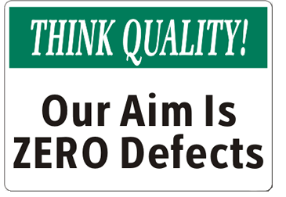
Zero Defects in SQA
Zero Defects Philosophy in Software Development Environment The Concept of Zero Defects:-
Zero Defects is a Lean philosophy, a mentality, or a movement introduced by Philip Crosby* that aims to reduce and minimize the number of defects and errors in a process in hopes of getting things done right the first time.
Zero Defects is a management tool aimed at the reduction of defects through prevention. It is directed at motivating people to prevent mistakes by developing a constant, conscious desire to do their job right the first time.

Slide 81
Its purpose is to design every process so that it is not possible to produce something of low quality. This is done assuming that the cost of preventing problems is less than fixing them later.
Zero Defects certainly seems good in theory, but how does it actually apply to software development? The following are few things that you should be aware before starting such initiative in your organization:
Is Zero Defects possible? OK, before we go any further we need to address this question; the answer is NO.

Slide 82
In reality, especially when we are talking about software development, it is just not possible to have zero defects. Those who promote the philosophy of zero defects say that the quest for perfection, even though everyone knows it is not possible, will at least increase quality.
But then why are they motivating people to work towards something that is not possible?
Wouldn’t it be better to just use something as the “Defect Reduction Initiative” instead of a Zero Defect approach?
When did all defects become the same? In the real world, we prioritize defects and take care of them in order from greatest to least importance.

Slide 83
Also, if we consider Return Of Investment (ROI), some defects at the bottom of this scale may never be taken care of at all. The Zero Defects movement assumes that all defects are equal and requires teams to spend time analyzing and resolving them without ever considering ROI.
To make things worse, organizations that are into Zero Defects will add quality (check) points that will slow down overall delivery but “ensure” these defects will never be repeated despite the fact that the process is not actually adding value. So how is the Zero Defects is actually reducing cost?
While one of the main ideas behind Zero Defects is to reduce cost, it will more than often do the opposite. Teams that need to fix all defects add tremendous labor-related effort and delays product releases to customer; both of these issues are highly correlated with cost.
One more thing to consider is that as teams resolve defects, there will be fewer defects left to find. This often means that finding defects that are left will take more time and effort, and with that, increases in cost occur.

Slide 84
Software Quality Assurance(SQA)
Methodologies and Techniques
Software quality assurance (SQA) is a planned and systematic pattern of actions necessary to provide adequate confidence that a software product conforms to requirements during software development.
SQA consists of methodologies and techniques of assessing the software development processes and methods, tools, and technologies used to ensure the quality of the developed software.
SQA is typically achieved through the use of well-defined standard practices, including tools and processes, for quality control to ensure the integrity and reliability of software.

Slide 85
SQA Techniques:-
There are several techniques for SQA. Auditing is the chief technique that is widely adopted.
However, we have a few other significant techniques as well.
Various SQA Techniques include:
1. Auditing: Auditing involves inspection of the work
products and its related information to determine if the set of standard processes were followed or not.
2. Reviewing : A meeting in which the software product is examined by both the internal and external stakeholders to seek their comments and approval.
3. Code Inspection: It is the most formal kind of review that does static testing to find bugs and avoid defect growth in the later stages.
It is done by a trained mediator/peer and is based on rules, checklist, entry and exit criteria. The reviewer should not be the author of the code.

Slide 86
4. Design Inspection:
Design inspection is done using a checklist that inspects the below areas of software design:
A. General requirements and design
B. Functional and Interface specifications
C. Conventions
D. Requirement traceability
E. Structures and interfaces
F. Logic
G. Performance
H. Error handling and recovery
I. Testability, extensibility
J. Coupling and cohesion

Slide 87
5. Simulation: Simulation is a tool that models the real-life situation in order to virtually examine the behavior of the system under study.
6. Functional Testing: It is a QA technique which verifies what the system does without considering how it does. This type of black Box testing mainly focuses on testing the system specifications or features.
7. Standardization: Standardization plays a crucial role in quality assurance. It decreases the ambiguity and guesswork, thus ensuring quality.

Slide 88
8. Static Analysis: It is a software analysis that is done by an auto mated tool without actually executing the program.
This technique is highly used for quality assurance in medical, nuclear and aviation software. Software metrics and reverse engineering are some popular forms of static analysis.
9. Walk through: Software walk through or code walkthrough is a kind of peer review where the developer guides the members of the development team to go through the product and raise queries, suggest alternatives, make comments regarding possible errors, standard violations or any other
issues.

Slide 89
10. Path Testing: It is a white box testing technique where the complete branch coverage is ensured by executing each independent path at least once.
11. Stress Testing: This type of testing is done to check how robust a system is by testing it under heavy load i.e. beyond normal conditions.
12. Six Sigma: Six Sigma is a quality assurance approach that aims at nearly perfect products or services. It is widely applied in many fields including software. The main objective of six sigma is process improvement so that the produced software is 99.76 % defect free.

Slide 90

Statistical Quality Assurance (SQA):- SQA is used to identify the potential variations in the manufacturing process and predict potential defects on a parts-per-million (PPM) basis. It provides a statistical description of the final product and addresses quality and safety issues that arise during manufacturing.
Collect and categorize information (i.e., causes) about software defects that occur 2) Attempt to trace each defect to its underlying cause (e.g., nonconformance to specifications, design error, violation of standards, poor communication with the customer) 3) Using the Pareto principle (80% of defects can be traced to 20% of all causes), isolate the 20%

Slide 91
A Sample for possible Cause for defects:
Incomplete or erroneous specifications
○ Misinterpretation of customer communication
○ Intentional deviation from specifications
○ Violation of programming standards
○ Errors in data representation
○ Inconsistent component interface
○ Errors in design logic
○ Incomplete or erroneous testing
○ Inaccurate or incomplete documentation
○ Errors in programming language translation of design
○ Ambiguous or inconsistent human/computer interface

Slide 92
"Six Sigma“: Introduction
Popularized by Motorola in the 1980s
Is the most widely used strategy for statistical quality assurance
Uses data and statistical analysis to measure and improve a company's operational performance
Identifies and eliminates defects in manufacturing and service related processes
The "Six Sigma" refers to six standard deviations (3.4 defects per a million occurrences)

Slide 93
Three core steps:
Define customer requirements, deliverables, and project goals via well-defined methods of customer communication
Measure the existing process and its output to determine current quality performance (collect defect metrics)
Analyze defect metrics and determine the vital few causes (the 20%)
Two additional steps are added for existing processes (and can be done in parallel)
Improve the process by eliminating the root causes of defects
Control the process to ensure that future work does not reintroduce the causes of defects

Slide 94
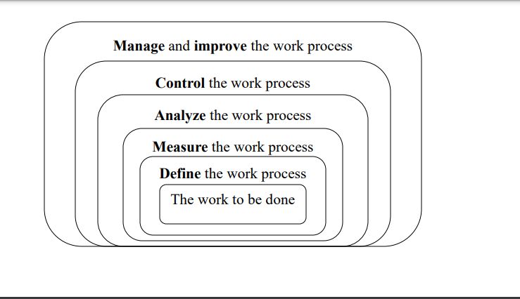
All of these steps need to be performed so that you can manage the process to accomplish something
You cannot effectively manage and improve a process until you first do these steps (in this order):

Slide 95
Total Quality Management
Before Study the Total Quality management we learn Quality management
Quality management : Quality management ensures that an organization, product or service is consistent.
It has four main components: quality planning, quality assurance, quality control and quality improvement.
Quality management is focused not only on product and service quality, but also on the means to achieve it.

Slide 96
Total Quality Management
Introduction: Total quality management (TQM) is a term that originated in the 1950s and is today used mainly in Japan. It is the equivalent of what other countries or organizations may call a company-wide quality management system, enterprise quality management system, or integrated quality management system, to name a few.
What is total quality management?
Total quality management (TQM) is the continual process of detecting and reducing or eliminating errors in manufacturing, streamlining supply chain management, improving the customer experience, and ensuring that employees are up to speed with training.

Slide 97
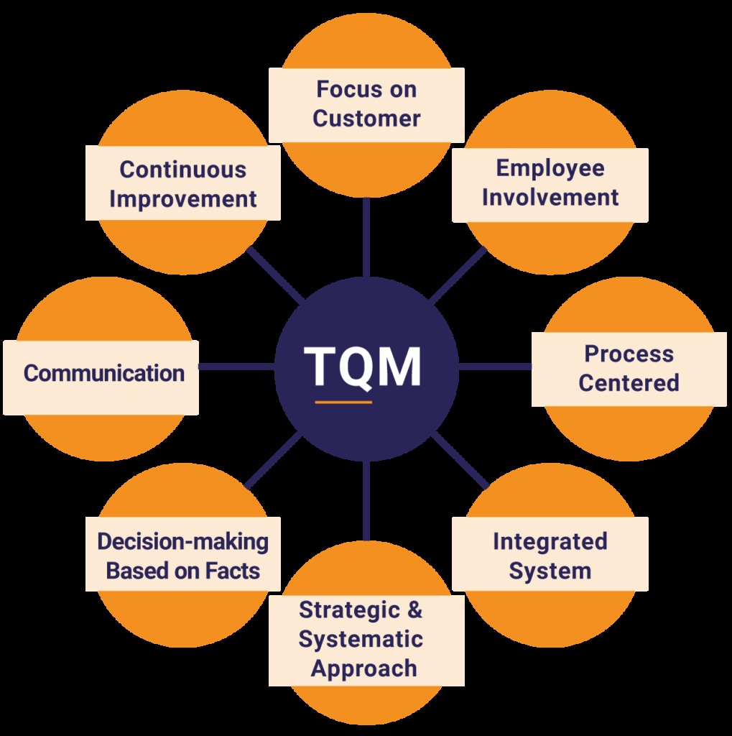

Slide 98
The term ‘total’ means the entire organization—all teams, departments and functions—is involved in quality management. The ‘system’ refers to the managerial and technological methods to achieve quality requirements and business objectives throughout an entire organization. Although it may go by various names, Juran believes ‘enterprise excellence’ to be a more appropriate name for TQM.
Total quality management ensures that every single employee is working towards the improvement of work culture, processes, services, systems and so on to ensure long term success.
Total Quality management can be divided into four categories:
Plan
Do
Check
Act

Slide 99
Planning Phase
Planning is the most crucial phase of total quality management. In this phase employees have to come up with their problems and queries which need to be addressed. They need to come up with the various challenges they face in their day to day operations and also analyze the problem’s root cause. Employees are required to do necessary research and collect relevant data which would help them find solutions to all the problems.
Doing Phase
In the doing phase, employees develop a solution for the problems defined in planning phase. Strategies are devised and implemented to overcome the challenges faced by employees. The effectiveness of solutions and strategies is also measured in this stage.
Checking Phase
Checking phase is the stage where people actually do a comparison analysis of before and after data to confirm the effectiveness of the processes and measure the results.
Acting Phase
In this phase employees document their results and prepare themselves to address other problems.

Slide 100
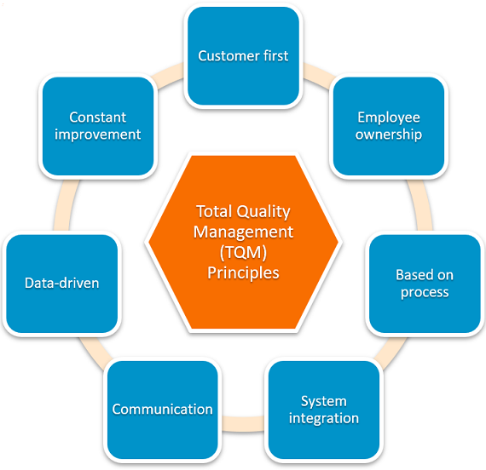
Key Principles of TQM/Total Quality Management Principles:-Total quality management has a number of key principles which—when implemented together—can move any organization towards business excellence.

Slide 101
Achieving this is accomplished with a laser-focus on the principles of TQM:
1. Customer first:
2. Employee ownership/ commitment:
3. Process-Centered based
4. System integration:
5. Effective Communication:
6. Data-driven:
7. Continuous/Constant improvement:

Slide 102
Achieving this is accomplished with a laser-focus on the principles of TQM:
1. Customer first: TQM’s first and foremost pillar of success is an unwavering focus on the customer’s experience in all interactions with the organization. From first contact through purchase and continued support, the customer should always be the main priority.
2. Employee ownership/ commitment: TQM requires the involvement of every team member to ensure that complete quality control is offered at every level. TQM doesn’t focus on a single department because the goal is to provide customers with a great experience from every level of the organization.

Slide 103
3. Process-Centered based TQM focuses on the creation and implementation of processes that provide organizations with the ability to find success and repeat it. Quantifying success and defining the steps taken to get there are essential for successful implementation of TQM.
4. System integration: TQM strategies revolve around leveraging every asset available to the company. This is best achieved through system integrations that combine disparate parts of the organization into a single, well-oiled machine working in complete synergy.

Slide 104
5. Effective Communication: TQM requires every team member to be at their best and to function as a value-adding member of that team. This means communication and transparency is a core tenet of successful TQM practices.
6. Data-driven: TQM doesn’t employ guesswork. Instead, data is leveraged for the improvement of the organization and decisions are made based on quantifiable facts.
7. Continuous/Constant improvement: TQM isn’t a one and done process. Perfection is impossible, so it must always be pursued to get the organization as close as possible to it.
These pillars of TQM act as a framework for every decision made within the methodology. Whenever your organization feels lost, the TQM ideals are your guiding stars for righting course.

Slide 105
How to implement TQM
The first step for implementing any new system is an honest assessment of the organization as it is today. Implementation of TQM is something that has to be applied to the current structure of the organization; there is no step-by-step guide that will tell you how to do it for your business. Each business is unique and requires its own approach, but the core tenets of TQM can guide each decision.
1. Emphasize customer satisfaction:-
Creating an emphasis on customer satisfaction will change the way departments think about their duties. If something they are doing isn’t aiding in the improvement of the quality of the product or increasing the customer’s experience, they aren’t headed in the right direction.

Slide 106
Each employee should take ownership of their role and be ready to consider ways in which they can improve their own department and outputs.
2. Communicate with everyone:
Communication throughout the organization is essential for educating everyone about the changes that are coming while also providing an avenue for receiving feedback. As they say, communication is a two-way street.
Employees will have a much easier time establishing a feeling of ownership over the process when they know their voice is heard and they had a hand in guiding the changes.

Slide 107
3. Manage errors
One of the most important aspects of delivering quality is managing errors. No matter how focused everyone is on driving quality, IT organizations will always run into one issue or another.
Creating processes that mitigate issues is essential for TQM success. Errors should be addressed and dealt with as quickly as possible of course, but they should also be recorded and tracked.
Recurrent issues could be indicative of a deeper issue, requiring large-scale changes to current procedures.
An error is an opportunity to assess a problem, but it’s also a chance to discover what is working.
Total quality management practitioners should take advantage of errors as a chance to learn from their mistakes and find ways to avoid them in the future.

